Slide 1

Asymmetric Information II HE3001, Microeconomics 3 Nanyang Technological University

Slide 2
Introduction
We have seen that market failure can be caused by market participants holding hidden types.
A closely related source of inefficiency arises from market participants taking hidden actions.
When (market) interactions involve actions which are unobserved by others, the individual might be more likely to take inefficient actions.
This second form of asymmetric information is referred to as moral hazard.

Slide 3
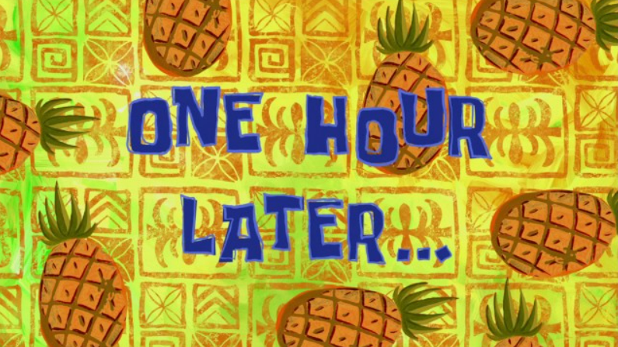
Examples of Moral hazard
If you have bicycle insurance, are you more likely to leave your bicycle unlocked?
If you have health insurance, are you more likely to eat unhealthy food?
If you are guaranteed a job at a firm before graduating, are you less likely to put in effort into your degree?
Make sure your men eat their food at the cookhouse!
It’s okay if you don’t eat.. But remember to scan at the cookhouse!

Slide 4
Examples of Moral hazard
With moral hazard problems, there are often two parties with misaligned objectives.
Insurer (maximise profits) vs Consumer (maximise utility)
Educator (transfer knowledge) vs Student (get qualification for a job)
Officer (reduce food waste) vs Specialist (don’t get into trouble)
That actions are not observed means that the desired (efficient) action of one party may not be the chosen action of the other.
Appropriate incentives need to be constructed in order to create (some) alignment.

Slide 5

Review Questions 1
Firms have to hire a temporary worker for 1 period and decide how to pay them. Is each of these scenarios a (potential) problem of moral hazard or adverse selection?
There are two types of workers, 1) hard workers and 2) lazy workers. Hard workers produce high output with probability 0.8, while lazy workers produce high output with probability 0.5. Firms cannot observe the type of a worker which is hired. - Adverse Selection
A worker, when hired, can choose to put in 1) hard work, or 2) lazy work. Hard work produces high output with probability 0.8, while lazy work produces high output with probability 0.5. Firms cannot observe the action of a worker which is hired. - Moral Hazard

Slide 6
Moral Hazard and Employment

Slide 7
Contract Design (Principal-Agent Problems)
Here we consider an employment scenario with hidden actions and the design of contracts to address the problems associated with moral hazard.
An agent is hired by a principal to do a task using a technology owned by the principal.
Only the agent knows the effort he/she exerts (asymmetric information).
The effort exerted affects the principal’s payoff.
The principal’s problem: design an incentive contract that induces the agent to exert the amount of effort that maximizes the principal’s payoff.
Notes:
This setup can be generalized to other kinds of scenarios!

Slide 8
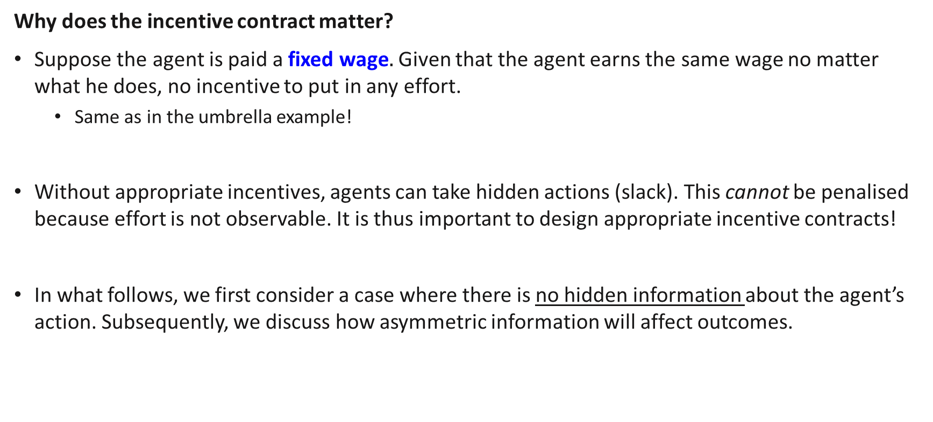
Moral Hazard and Employment
Why does the incentive contract matter?
Suppose the agent is paid a fixed wage$.$ Given that the agent earns the same wage no matter what he does, no incentive to put in any effort.
Same as in the umbrella example!
Without appropriate incentives, agents can take hidden actions (slack). This cannot be penalised because effort is not observable. It is thus important to design appropriate incentive contracts!
In what follows, we first consider a case where there is no hidden information about the agent’s action. Subsequently, we discuss how asymmetric information will affect outcomes.

Slide 9
Contract Design with Perfect Information

Slide 10
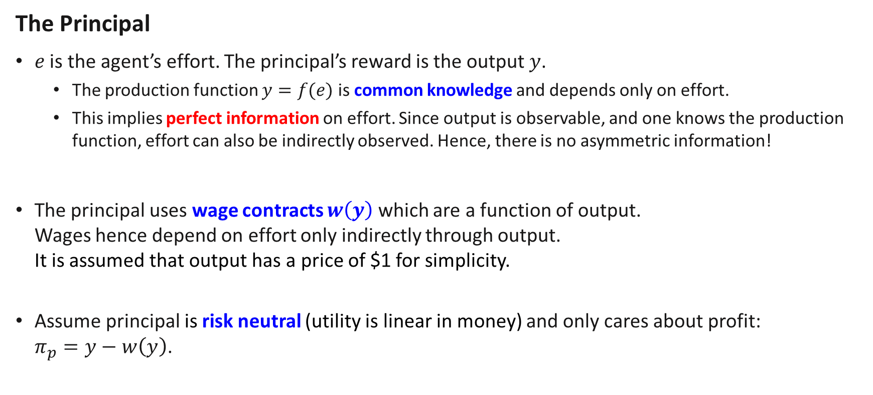
Moral Hazard and Employment
The Principal
$e$ is the agent’s effort. The principal’s reward is the output $y$.
The production function $y=f(e)$ is common knowledge and depends only on effort.
This implies perfect information on effort. Since output is observable, and one knows the production function, effort can also be indirectly observed. Hence, there is no asymmetric information!
The principal uses wage contracts $w\left(y\right)$ which are a function of output. Wages hence depend on effort only indirectly through output. It is assumed that output has a price of $1 for simplicity.
Assume principal is risk neutral (utility is linear in money) and only cares about profit: $π_{p}=y−w\left(y\right)$.

Slide 11
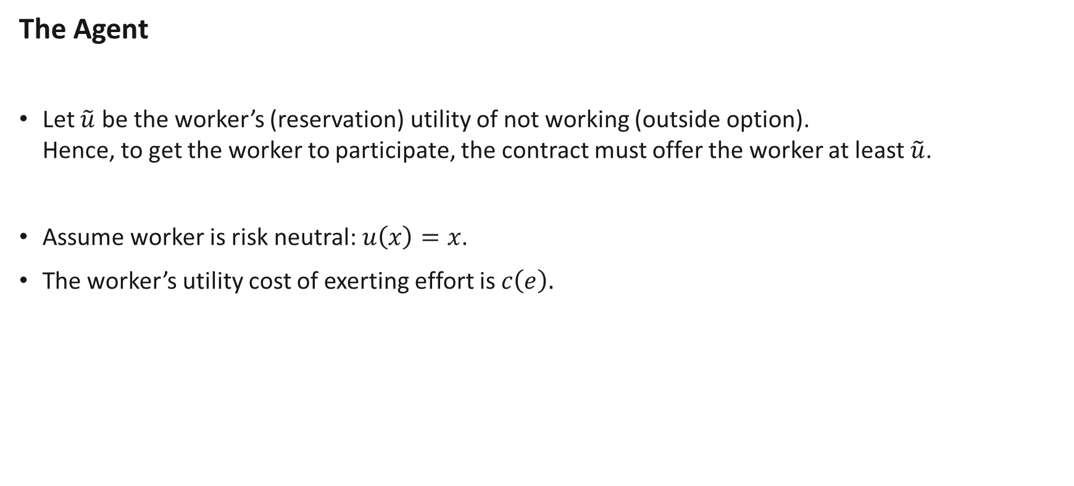
Moral Hazard and Employment
The Agent
Let $\tilde{u}$ be the worker’s (reservation) utility of not working (outside option). Hence, to get the worker to participate, the contract must offer the worker at least $\tilde{u}$.
Assume worker is risk neutral: $u\left(x\right)=x$.
The worker’s utility cost of exerting effort is $c\left(e\right).$

Slide 12
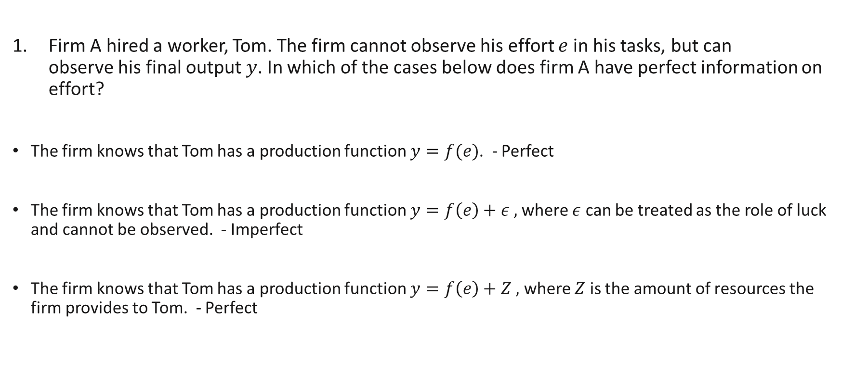
Review Questions 2
Firm A hired a worker, Tom. The firm cannot observe his effort $e$ in his tasks, but can observe his final output $y$. In which of the cases below does firm A have perfect information on effort?
The firm knows that Tom has a production function $y=f(e)$. - Perfect
The firm knows that Tom has a production function $y=f\left(e\right)+ε ,$ where $ε$ can be treated as the role of luck and cannot be observed. - Imperfect
The firm knows that Tom has a production function $y=f\left(e\right)+Z ,$ where $Z$ is the amount of resources the firm provides to Tom. - Perfect

Slide 13
The First Best Outcome

Slide 14


Moral Hazard and Employment $−$ First Best
To judge how well an incentive contract is performing, we first need a benchmark for comparison.
This benchmark is called the first best as it is socially efficient.
To do this, we derive the solution if the principal can “force” the agent to choose an effort level.
In other words, effort is contractible.
In this case, the wage structure is irrelevant for the agent’s choice of effort. Principal only needs to choose some $W=w(y)$ such that the agent is willing to participate.

Slide 15

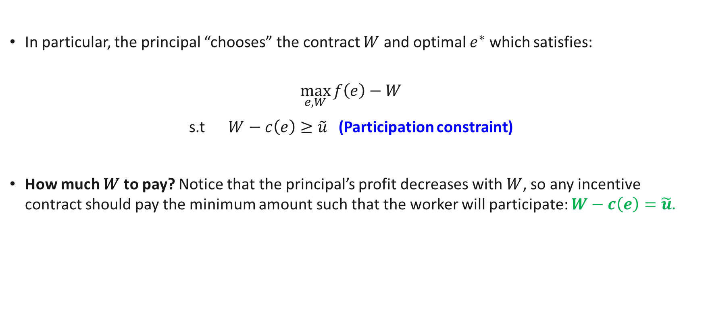
Moral Hazard and Employment $−$ First Best
In particular, the principal “chooses” the contract $W$ and optimal $e^{∗}$ which satisfies:
$$\max_{e,W}{f\left(e\right)−W}$$
s.t $W−c\left(e\right)≥\tilde{u}$ (Participation constraint)
How much $W$ to pay? Notice that the principal’s profit decreases with $W$, so any incentive contract should pay the minimum amount such that the worker will participate: $W−c\left(e\right)=\tilde{u}.$
$$y−w(y)$$
Meaning: worker’s utility must be at least equal to the outside option.

Slide 16
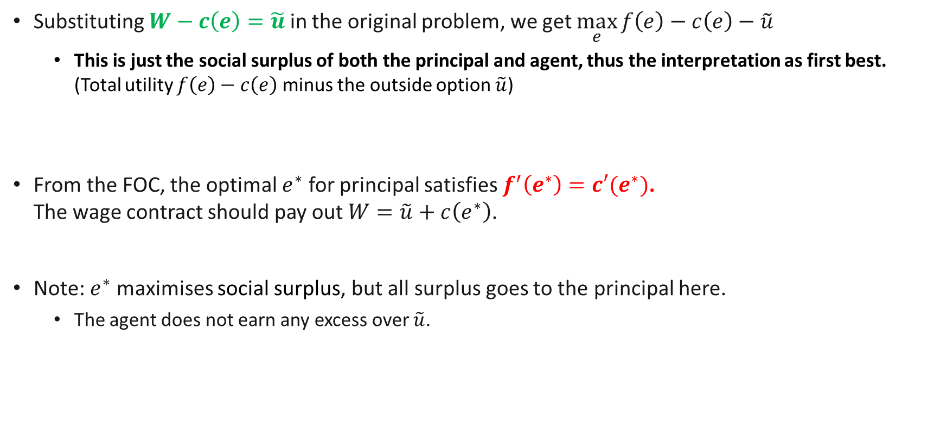
Moral Hazard and Employment $−$ First Best
Substituting $W−c\left(e\right)=\tilde{u}$ in the original problem, we get $\max_{e}{f\left(e\right)−c\left(e\right)−\tilde{u}}$
This is just the social surplus of both the principal and agent, thus the interpretation as first best. (Total utility $f\left(e\right)−c\left(e\right)$ minus the outside option $\tilde{u}$)
From the FOC, the optimal $e^{∗}$ for principal satisfies $f^{′}\left(e^{∗}\right)=c′(e^{∗})$. The wage contract should pay out $W=\tilde{u}+c\left(e^{∗}\right)$.
Note: $e^{∗}$ maximises social surplus, but all surplus goes to the principal here.
The agent does not earn any excess over $\tilde{u}$.

Slide 17
Contracts Under Perfect Information

Slide 18
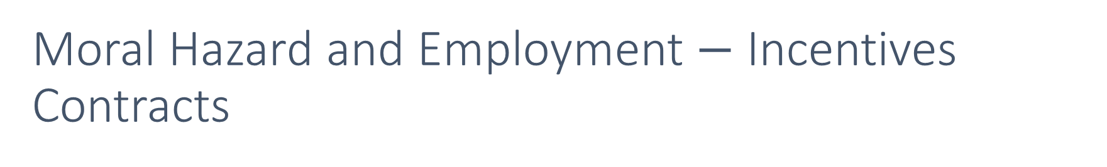
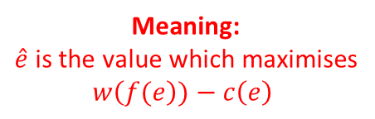

Moral Hazard and Employment $−$ Incentives Contracts
In most cases, one cannot actually force the agent to put in the first best effort $e^{∗}$, the worker must indeed want to choose it. Wages must vary with effort!
For an incentive $w\left(y\right)≡w\left(f\left(e\right)\right),$the worker’s choice $\hat{e}$ is as follows:
$\hat{e}=argmax w\left(f(e\right))−c\left(e\right)$ (Incentive compatibility constraint)
I.e. the worker’s choice $\hat{e}$ maximises his/her own utility.
If we want $\hat{e}=e^{∗}$, we need to set appropriate incentives.
Meaning:
$\hat{e}$is the value which maximises $w\left(f(e\right))−c\left(e\right)$

Slide 19

Moral Hazard and Employment $−$ Incentives Contracts
Principal’s Full Problem
$$\max_{w}{f\left(e\right)−w(f\left(e\right))}$$
s.t $w\left(f\left(e\right)\right)−c\left(e\right)≥\tilde{u}$ (Participation constraint, PC) $e=argmax w\left(f(e\right))−c\left(e\right)$ (Incentive compatibility constraint, ICC)
The ICC must always hold: agents must always make the choice to maximise their own utility!
The PC may or may not hold with equality. Subject to the above, the principal will want the PC to hold as close to equality as possible since $w\left(f\left(e\right)\right)−c\left(e\right)=\tilde{u}$ means that he is paying the minimum to agent.
Can’t choose e anymore

Slide 20
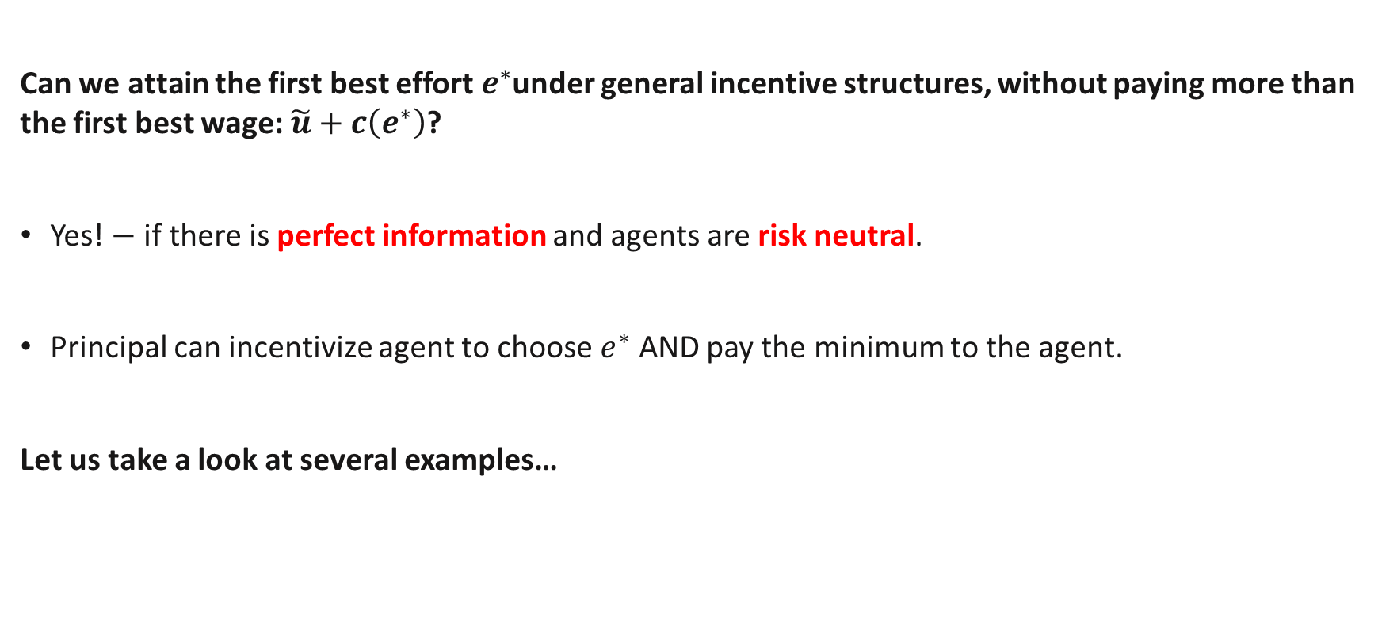
Moral Hazard and Employment $−$ Incentives Contracts
Can we attain the first best effort $e^{∗}$under general incentive structures, without paying more than the first best wage: $\tilde{u}+c\left(e^{∗}\right)$?
Yes! $−$ if there is perfect information and agents are risk neutral.
Principal can incentivize agent to choose $e^{∗}$ AND pay the minimum to the agent.
Let us take a look at several examples…

Slide 21
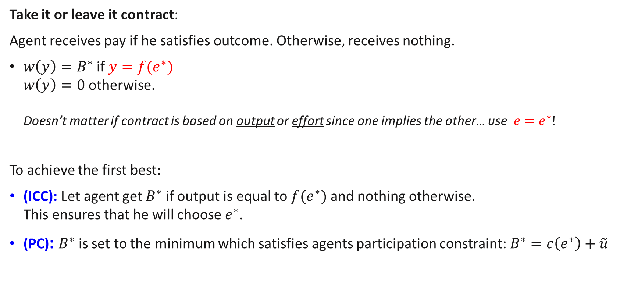
Take it or Leave it with Perfect Information
Take it or leave it contract:
Agent receives pay if he satisfies outcome. Otherwise, receives nothing.
$w\left(y\right)=B^{∗}$ if $y={f(e}^{∗})$ $w\left(y\right)=0$otherwise. Doesn’t matter if contract is based on output or effort since one implies the other… use $e=e^{∗}!$
To achieve the first best:
(ICC): Let agent get $B^{∗}$ if output is equal to $f(e^{∗})$ and nothing otherwise. This ensures that he will choose $e^{∗}$.
(PC): $B^{∗}$ is set to the minimum which satisfies agents participation constraint:$B^{∗}=c\left(e^{∗}\right)+\tilde{u}$

Slide 22
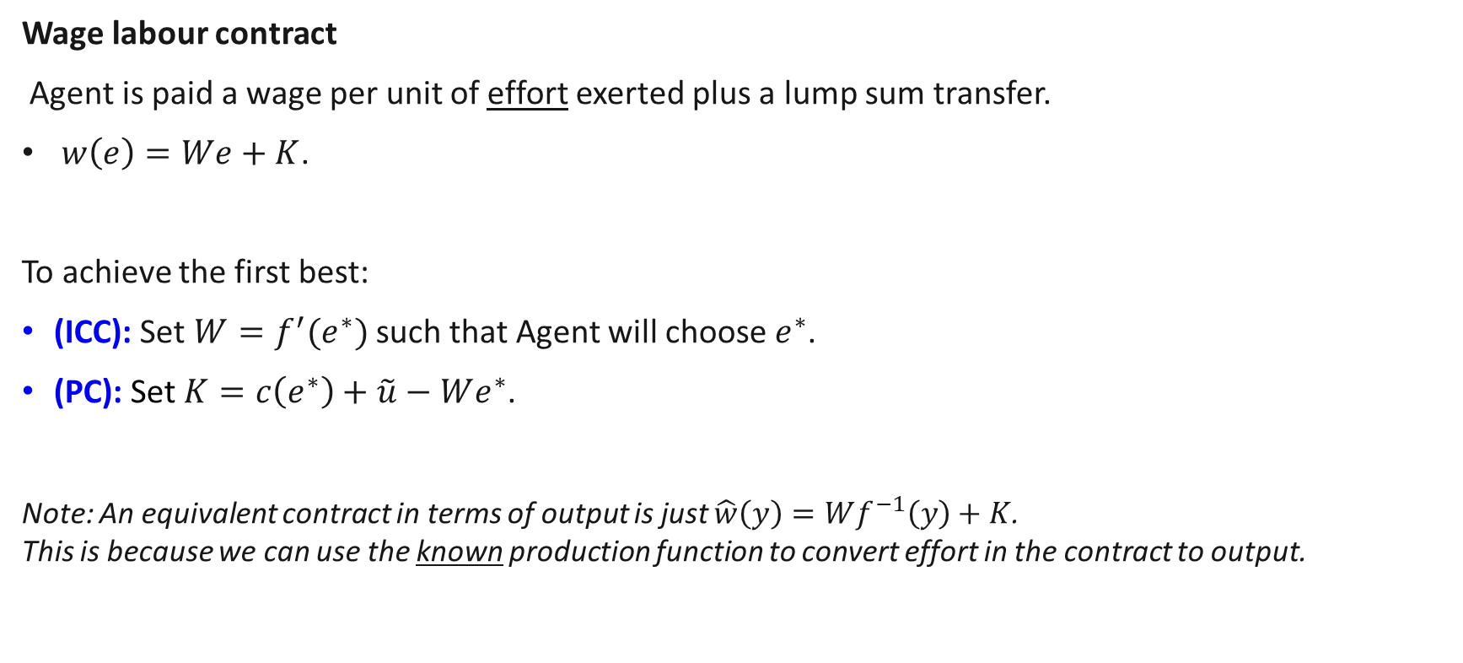
Wage Labour with Perfect Information
Wage labour contract
Agent is paid a wage per unit of effort exerted plus a lump sum transfer.
$w\left(e\right)=We+K$.
To achieve the first best:
(ICC): Set $W=f^{′}(e^{∗})$ such that Agent will choose $e^{∗}$.
(PC): Set $K=c\left(e^{∗}\right)+\tilde{u}−We^{∗}$.
Note: An equivalent contract in terms of output is just $\hat{w}\left(y\right)=Wf^{−1}\left(y\right)+K$. This is because we can use the known production function to convert effort in the contract to output.

Slide 23
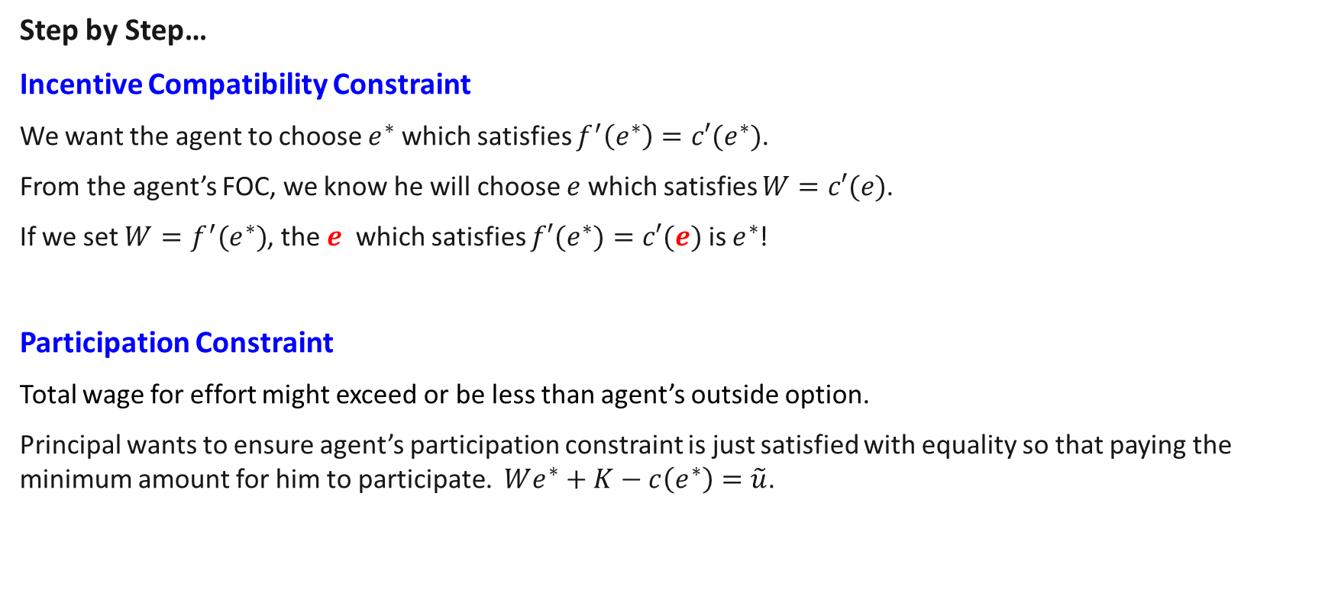
Wage Labour with Perfect Information
Step by Step…
Incentive Compatibility Constraint
We want the agent to choose $e^{∗}$ which satisfies $f^{′}\left(e^{∗}\right)=c′(e^{∗})$.
From the agent’s FOC, we know he will choose $e$ which satisfies $W=c′(e)$.
If we set $W=f^{′}(e^{∗})$, the $e$ which satisfies $f′(e^{∗})=c′(e)$ is $e^{∗}$!
Participation Constraint
Total wage for effort might exceed or be less than agent’s outside option.
Principal wants to ensure agent’s participation constraint is just satisfied with equality so that paying the minimum amount for him to participate. $We^{∗}+K−c\left(e^{∗}\right)=\tilde{u}$.

Slide 24

Rental Contracts with Perfect Information
Rental contract:
Principal rents out technology to the agent for lump sum $R$ while letting the agent keep the rest of the profits.
$w\left(y\right)=y−R$
To achieve the first best:
(ICC) Automatically satisfied
(PC) Set $R=f(e^{∗})−c\left(e^{∗}\right)−\tilde{u}$
Do you understand why?

Slide 25
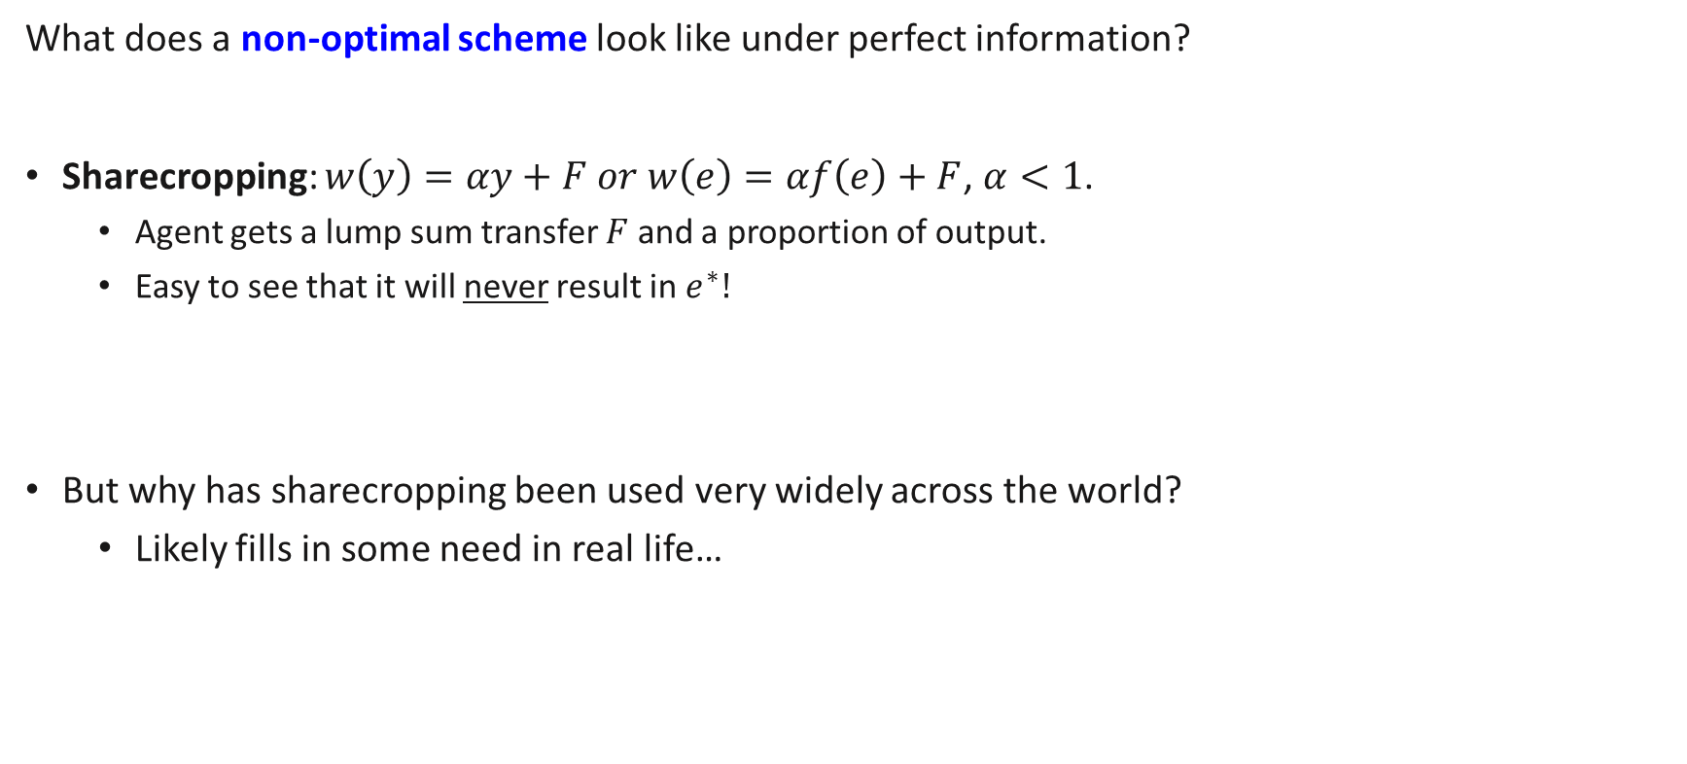
A non-optimal wage scheme?
What does a non-optimal scheme look like under perfect information?
Sharecropping: $w\left(y\right)=αy+F or w\left(e\right)=αf\left(e\right)+F$, $α<1$.
Agent gets a lump sum transfer $F$ and a proportion of output.
Easy to see that it will never result in $e^{∗}!$
But why has sharecropping been used very widely across the world?
Likely fills in some need in real life…

Slide 26

Review Questions 3
The production function of Bob is $y=4e+6$. His cost of effort is $2e^{2}$ and he has an outside option of 2. His boss wants to use an output contract $w\left(y\right)=Ay+B$.
(Also equivalent to a labour contract because of perfect information):
a) What is the first best level of effort? 1
b) What are the values of $A$ and $B$ in the optimal contract? A=1, B= - 6

Slide 27
Contracts Under Imperfect Information

Slide 28
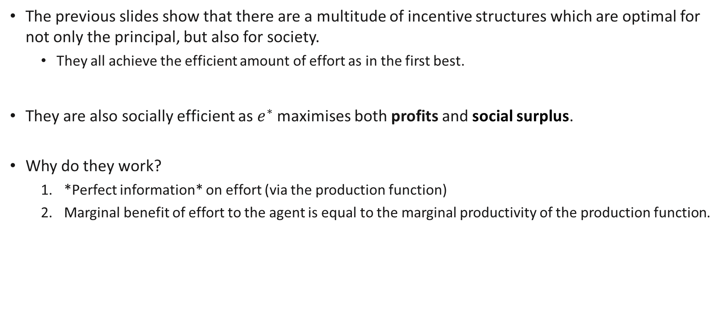
Discussion
The previous slides show that there are a multitude of incentive structures which are optimal for not only the principal, but also for society.
They all achieve the efficient amount of effort as in the first best.
They are also socially efficient as $e^{∗}$ maximises both profits and social surplus.
Why do they work?
*Perfect information* on effort (via the production function)
Marginal benefit of effort to the agent is equal to the marginal productivity of the production function.
Notes:
I.e. they align the incentives of the agent with that of society.

Slide 29
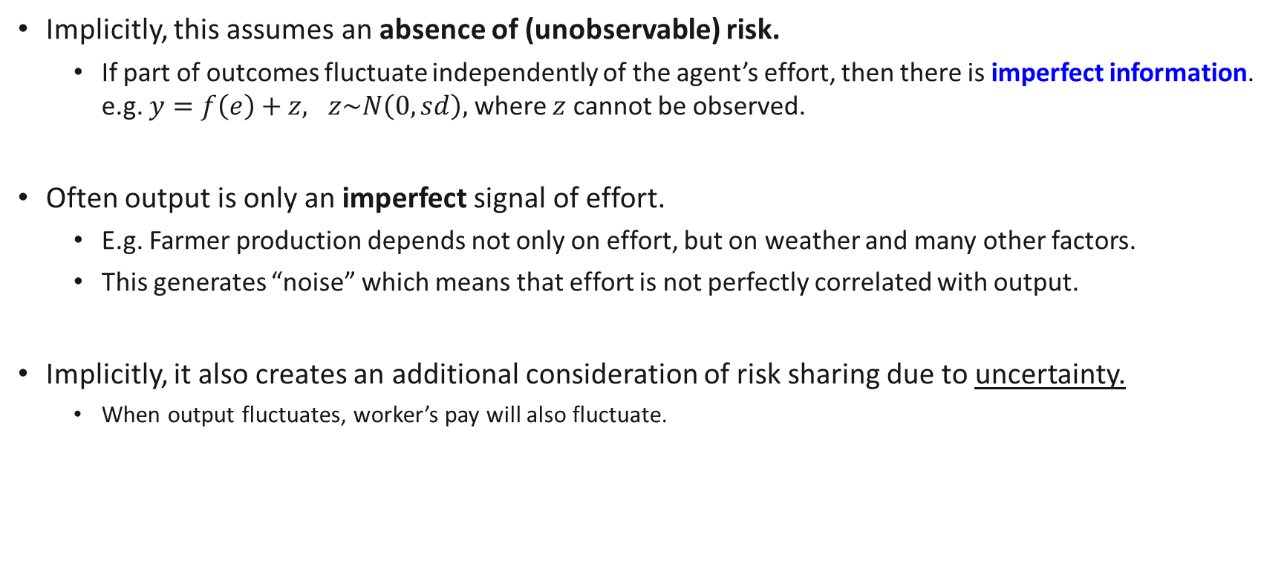
Adding Risk..
Implicitly, this assumes an absence of (unobservable) risk.
If part of outcomes fluctuate independently of the agent’s effort, then there is imperfect information. e.g. $y=f\left(e\right)+z, z\sim N\left(0,sd\right),$ where $z$ cannot be observed.
Often output is only an imperfect signal of effort.
E.g. Farmer production depends not only on effort, but on weather and many other factors.
This generates “noise” which means that effort is not perfectly correlated with output.
Implicitly, it also creates an additional consideration of risk sharing due to uncertainty.
When output fluctuates, worker’s pay will also fluctuate.
Notes:
.

Slide 30
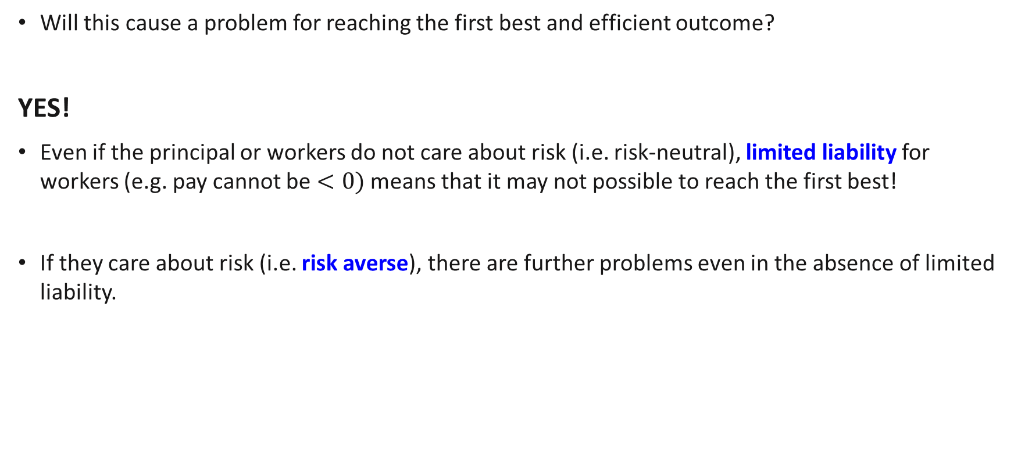
Adding Risk..
Will this cause a problem for reaching the first best and efficient outcome?
YES!
Even if the principal or workers do not care about risk (i.e. risk-neutral), limited liability for workers (e.g. pay cannot be $<0)$ means that it may not possible to reach the first best!
If they care about risk (i.e. risk averse), there are further problems even in the absence of limited liability.
Notes:
.

Slide 31
Contracts under Risk and Limited Liability

Slide 32
Incentive contracts with risk
A principal hires an agent to produce output. The agent can choose to Work Hard or Slack.
There are 2 potential levels of output, High and Low which occur partly due to chance.
Effort by the agent increases the chance of High output.
 | P(Low) | P(High)
Slack | 0.5 | 0.5
Work Hard | 0.2 | 0.8
The output level is observable by the principal, but not the effort choice of the agent. Principal chooses wages $w_{l}$ and $w_{h}$ to pay based on observed output.

Slide 33
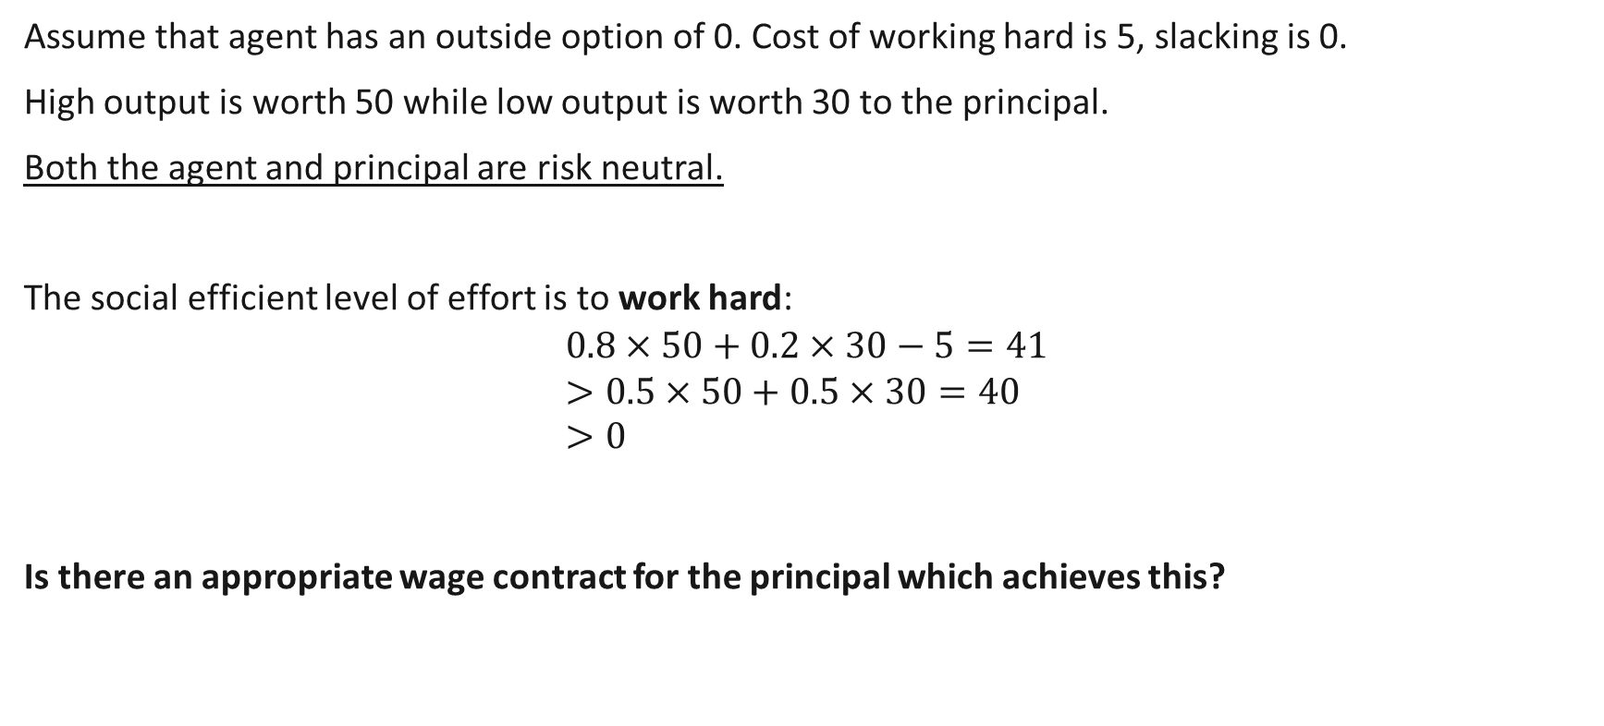
Incentive contracts with risk
Assume that agent has an outside option of 0. Cost of working hard is 5, slacking is 0.
High output is worth 50 while low output is worth 30 to the principal.
Both the agent and principal are risk neutral.
The social efficient level of effort is to work hard: $$0.8×50+0.2×30−5=41 \\ >0.5×50+0.5×30=40 \\ >0$$
Is there an appropriate wage contract for the principal which achieves this?

Slide 34
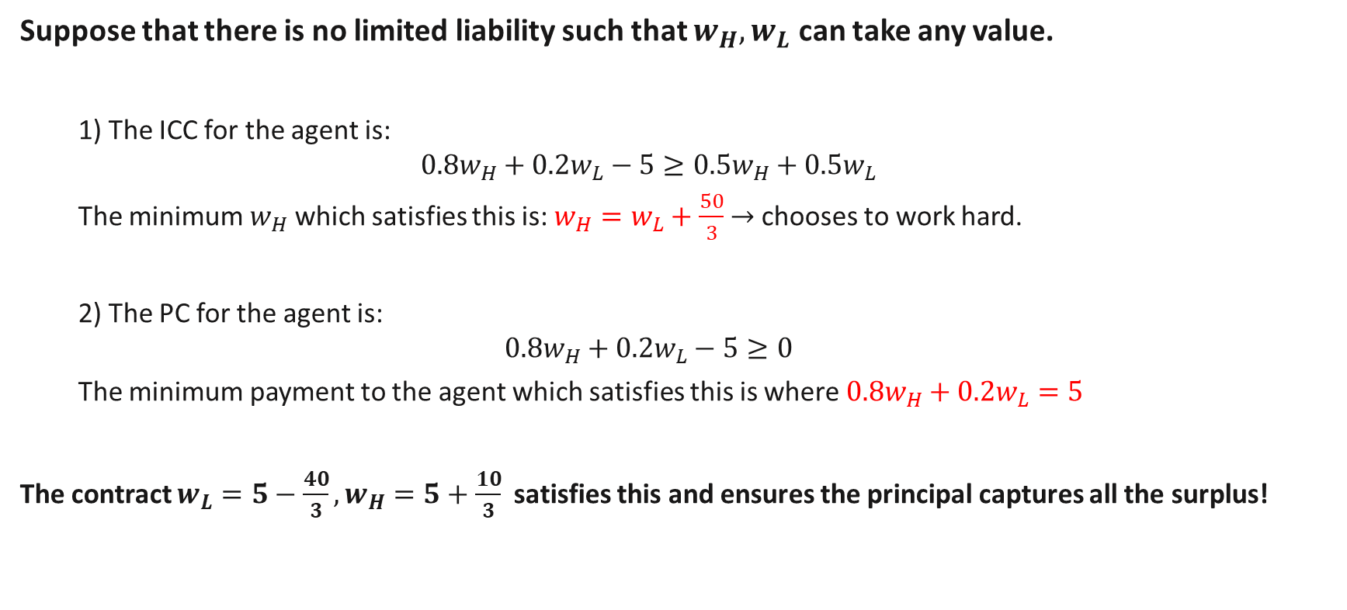
Incentive contracts with risk (No limited liability)
Suppose that there is no limited liability such that $w_{H}, w_{L}$ can take any value.
1) The ICC for the agent is:
$${0.8w}_{H}+0.2w_{L}−5≥{0.5w}_{H}+0.5w_{L}$$
The minimum $w_{H}$ which satisfies this is: $w_{H}=w_{L}+\frac{50}{3}$ $→$ chooses to work hard.
2) The PC for the agent is:
$${0.8w}_{H}+0.2w_{L}−5≥0$$
The minimum payment to the agent which satisfies this is where ${0.8w}_{H}+0.2w_{L}=5$
The contract $w_{L}=5−\frac{40}{3}, w_{H}=5+\frac{10}{3}$ satisfies this and ensures the principal captures all the surplus!
Notes:
Since the principal captures all the surplus, this means that he will also want to incentivize high effort.

Slide 35
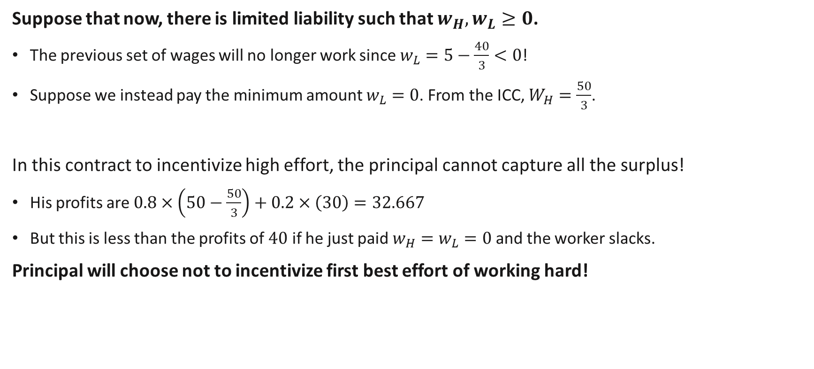
Incentive contracts with risk (With limited liability)
Suppose that now, there is limited liability such that $w_{H}, w_{L}≥0$.
The previous set of wages will no longer work since $w_{L}=5−\frac{40}{3}<0$!
Suppose we instead pay the minimum amount $w_{L}=0$. From the ICC, $W_{H}=\frac{50}{3}$.
In this contract to incentivize high effort, the principal cannot capture all the surplus!
His profits are $0.8×\left(50−\frac{50}{3}\right)+0.2×\left(30\right)=32.667$
But this is less than the profits of $40$ if he just paid $w_{H}=w_{L}=0$ and the worker slacks.
Principal will choose not to incentivize first best effort of working hard!

Slide 36
Contracts under Risk and Risk Aversion

Slide 37
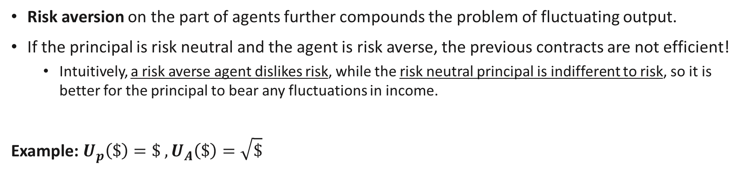

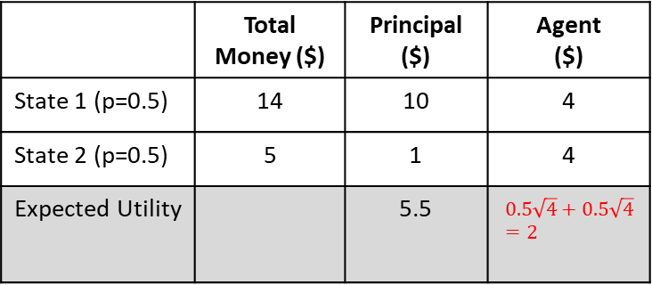
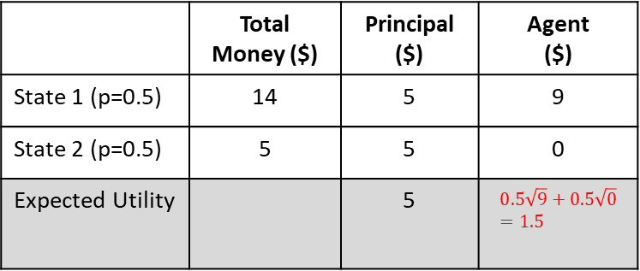
When agents are risk averse…
Risk aversion on the part of agents further compounds the problem of fluctuating output.
If the principal is risk neutral and the agent is risk averse, the previous contracts are not efficient!
Intuitively, a risk averse agent dislikes risk, while the risk neutral principal is indifferent to risk, so it is better for the principal to bear any fluctuations in income.
Example: $U_{p}\left(\$\right)=\$ , U_{A}\left(\$\right)=\sqrt{\$}$
 | Total Money ($) | Principal ($) | Agent ($)
State 1 (p=0.5) | 14 | 5 | 9
State 2 (p=0.5) | 5 | 5 | 0
Expected Utility |  | 5 | $$0.5\sqrt{9}+0.5\sqrt{0}=1.5$$
 | Total Money ($) | Principal ($) | Agent ($)
State 1 (p=0.5) | 14 | 10 | 4
State 2 (p=0.5) | 5 | 1 | 4
Expected Utility |  | 5.5 | $$0.5\sqrt{4}+0.5\sqrt{4}=2$$
$$≪$$
Principal can give less money on average to Agents, with both of them happier!
Notes:
.

Slide 38
Incentives Contracts with Asymmetric Information
Assume that in a risky environment,
Agents are risk averse
Principals are risk neutral.
Recall that the socially efficient outcome requires the risk neutral agent to bear more of the risk.
Previously considered contracts are now not/less feasible or become inefficient.
Notes:
More generally, an organization or group of individuals can be assumed to be less risk averse than agents.

Slide 39
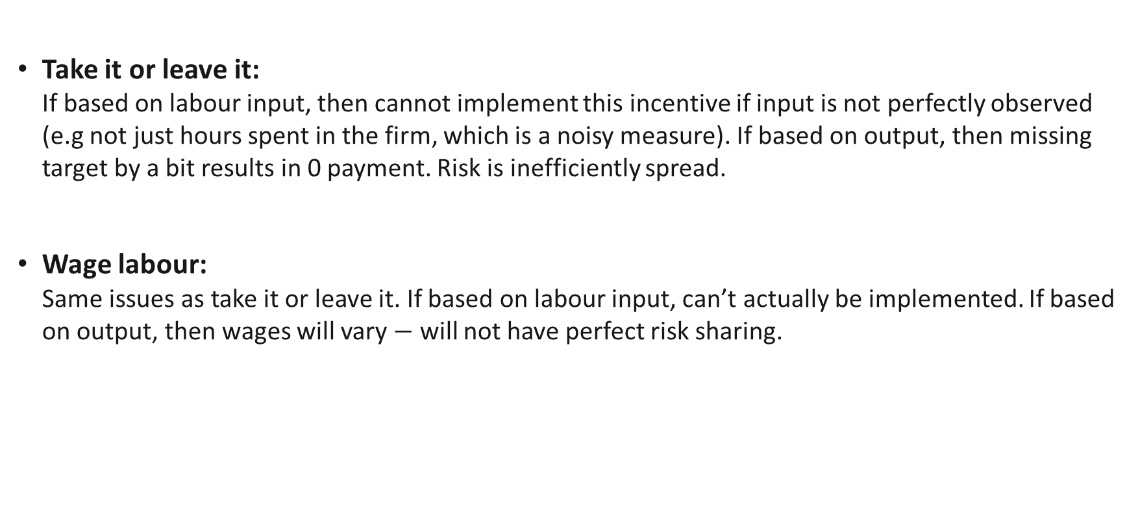
Incentives Contracts with Asymmetric Information
Take it or leave it: If based on labour input, then cannot implement this incentive if input is not perfectly observed (e.g not just hours spent in the firm, which is a noisy measure). If based on output, then missing target by a bit results in 0 payment. Risk is inefficiently spread.
Wage labour: Same issues as take it or leave it. If based on labour input, can’t actually be implemented. If based on output, then wages will vary $−$ will not have perfect risk sharing.

Slide 40
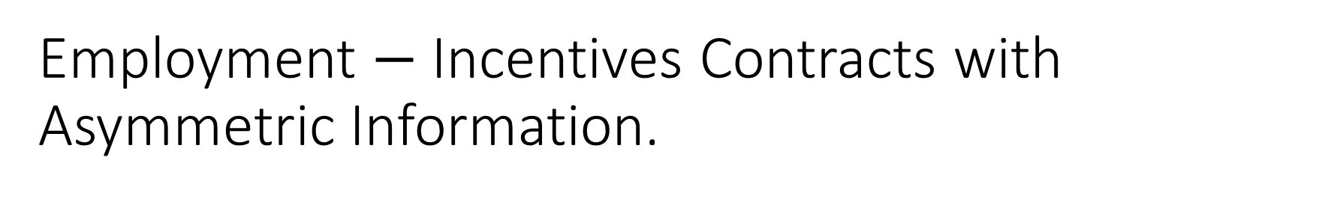
Employment $−$ Incentives Contracts with Asymmetric Information.
Rental contracts: If output has a random component, worker will have to bear all the risk. This is not efficient if worker is more risk averse than owner.
Sharecropping: This is sort of an in-between. The payment depends in part on observed output, with some fixed payments. This gives the worker some incentive to exert effort, but without bearing all the risk. Could serve as something like a second best..?

Slide 41
Review Questions 4
For each of the following statements, state whether they are True or False.
In a risky environment where everyone is risk-neutral, there will never be any impact on efficiency. F
In a risky environment where everyone is risk-neutral, there will always be an impact on efficiency. F
In a risky environment where agents are risk neutral while the principal is risk-averse, it is efficient for all risk to be assigned to the principal. F

Slide 42
General Optimal Contracts

Slide 43
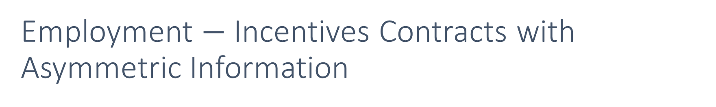
Employment $−$ Incentives Contracts with Asymmetric Information
In an optimal contract, a risk neutral principal trades off motivating effort (which requires agents’ income to vary more with output) with gains made from providing insurance to risk-averse agents (which requires agents’ income to vary less with output).
This gives us a second-best outcome compared to the first-best outcome when effort can be (indirectly) observed.
A large body of work in economics: contract and information theory deals with this.

Slide 44

Designing optimal contracts
In general, suppose we denote the parameters of the wage contract by $α$ and consider wage contracts of the form $w\left(y,α\right)$.
An optimal wage contract given a risk neutral principal and risk averse agent is one which satisfies the following:
$$\max_{α}{ E[y}−w\left(y,α\right)]$$
s.t
$E[ u\left(w\left(f\left(\hat{e}\right),α\right)\right)−c(e)]≥\tilde{u}$ (Participation constraint)
$\hat{e}=\underset{e}{argmax}{E[ u\left(w\left(f\left(e\right),α\right)\right)−c(e)]}$ (Incentive compatibility constraint)
If there is limited liability, then $w\left(f\left(\hat{e}\right)\right)≥k$in every realized state.

Slide 45
Key Learning Outcomes
Understand how imperfect information about actions lead to problems of moral hazard.
Differences from the first best.
Know the different elements of contracts and solving for optimal contracts.
Incentive compatibility constraint
Participation constraint
Understand when can contracts achieve the first best, and when they can’t.
With and without risk
With and without limited liability

Slide 46
Readings
Varian, Chapter 38
https://marginalrevolution.com/marginalrevolution/2024/05/migrants-at-sea-unintended-consequences-of-search-and-rescue-operations.html

